Slide 1
Contact us / Support

Slide 2
Banner

Slide 3

Insert the banner template as shown (ill insert the picture)

Slide 4
Intro Text

Slide 5
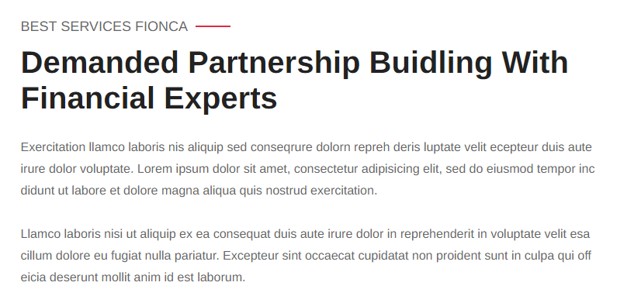
Insert normal text (Full width of the page)
Make sure that the Titles are included as shown. Ill edit the titles and text.

Slide 6
Insert FAQ

Slide 7
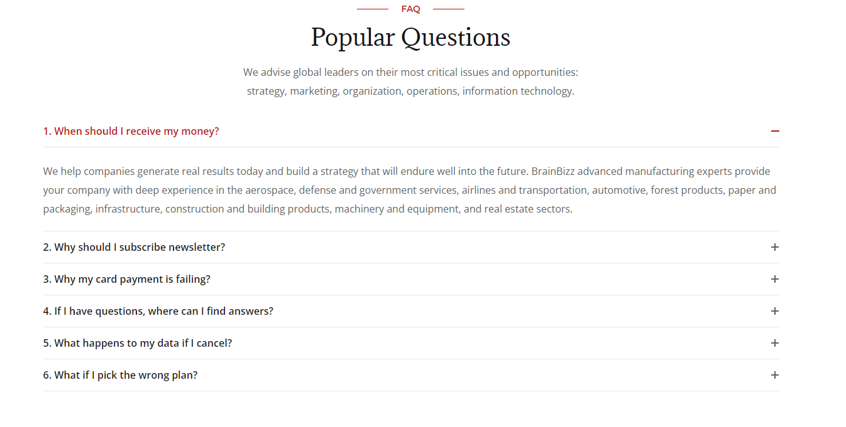
Insert the same type of FAQ that you used on the Share Prices / Australian managed fund website, just make random text or use the Shareprices text at this stage. ill edit, add the titles and text

Slide 8
Didn’t find what you were looking for

Slide 9

Add the contact bar as found on the first home page

Slide 10
Add Testimonial section

Slide 11

Add this part from the Managed fund template
Ill replace the photo and text
http://preview.themeforest.net/item/brainbizz-finance-business-wordpress-theme/full_screen_preview/22835404?_ga=2.50342250.258836864.1624524424-1952668530.1593696106

Slide 12
Add a way to submit a testimonial through Email, Facebook twitter, Instagram etc.

Slide 13
Add contact us section

Slide 14

Insert this from homepage 3 and edit it like what's seen on the following slides

Slide 15
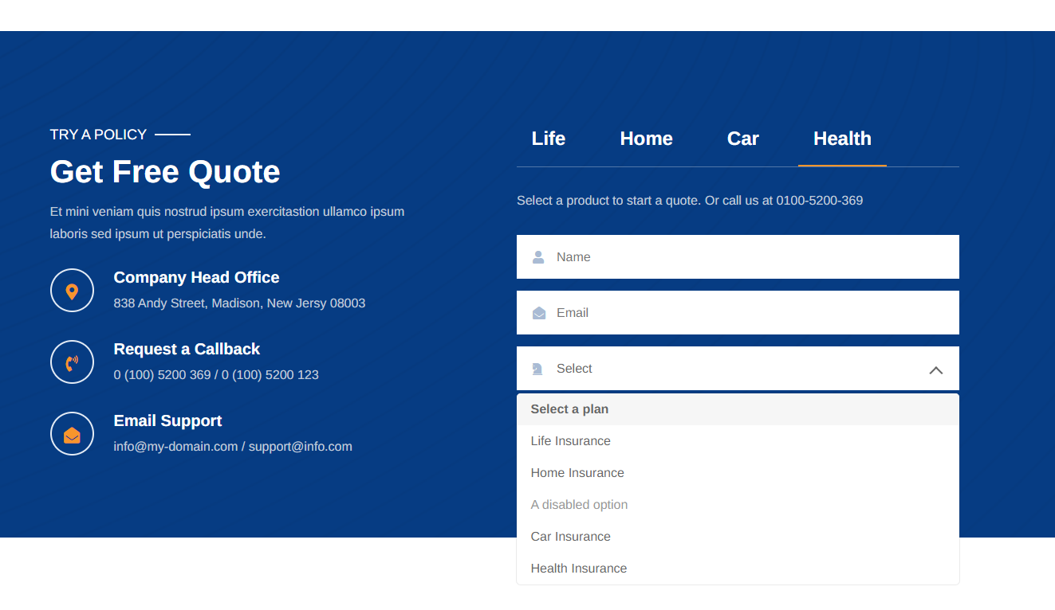
Add a contact us section that just has the following

Slide 16
The fields should include
Contact Name
Name of Restaurant / Venue (if required)
Email
Contact Number
Select Inquiry
Message

Slide 17
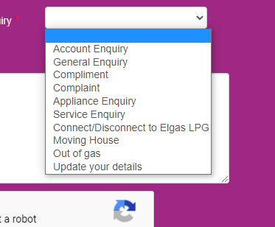
The Select Dropdown menus should include the following options
Register your Venue
Claim your existing venue listing
Technical assistance required
Posting a review
Marketing assistance inquiry
Upgrading your services
Compliments
Testimonials
Complaints
other.

Slide 18
Add contact information
section

Slide 19
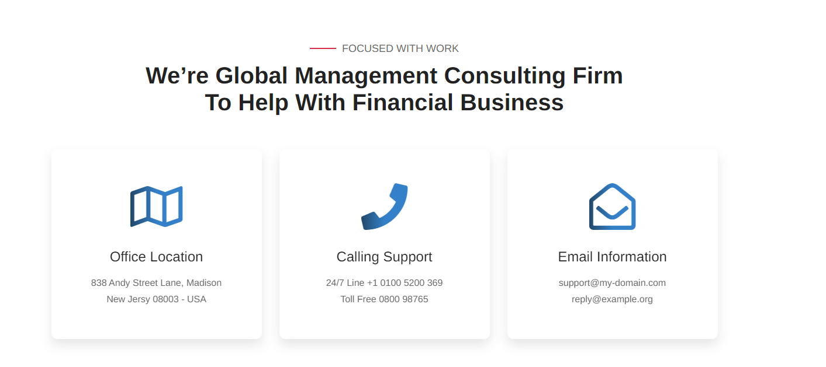

Slide 20
Add legal document section

Slide 21

We will need to have a legal section that displays the following information.
Privacy Policy
Terms & Conditions
Disclaimer
http://preview.themeforest.net/item/brainbizz-finance-business-wordpress-theme/full_screen_preview/22835404?_ga=2.50342250.258836864.1624524424-1952668530.1593696106
Maybe have something like this that has a mouseover effect.

Slide 22
Footer

Slide 23
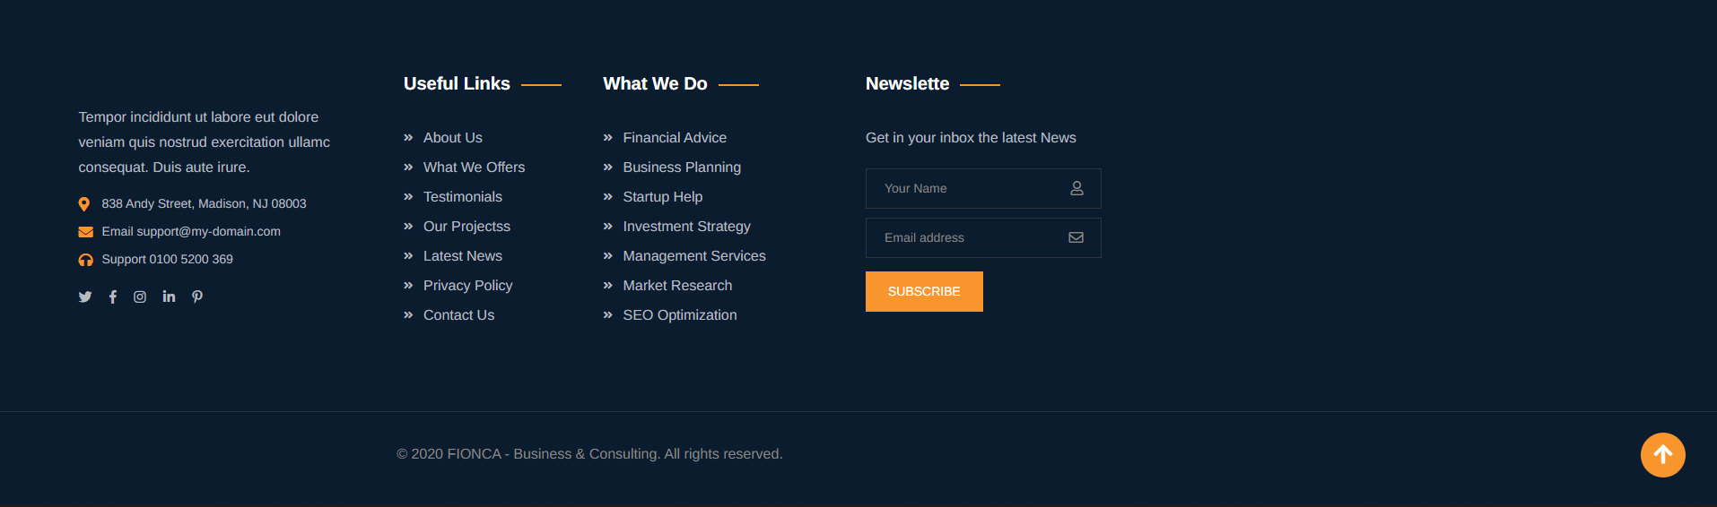
Insert this from homepage 2

